Slide 1

Finite State Automata in Natural Language Processing
Technical presentation
DSA0304 – Natural Language Processing
Guided By:
Dr. T. DEVI
Professor
SIMATS Engineering
Suguna G (192425032)
Department of AI&ML
SIMATS Engineering

Slide 2
INTRODUCTION
Finite State Automata in Natural Language Processing
NLP enables computers to understand and process human language.
Finite State Automata (FSA) is a mathematical model for recognizing text patterns.
FSA is widely used in lexical analysis, tokenization, and language recog

Slide 3
Deterministic and Non-Deterministic Finite Automata
Deterministic Finite Automata (DFA)
One transition for each input symbol.
Single processing path.
Fast and simple to implement.
Non-Deterministic Finite Automata (NFA)
Multiple transitions for an input.
Supports ε (epsilon) transitions.
Flexible and easily converted to DFA.

Slide 4
Algorithm Design and Model
Algorithm :
Read the input string.
Start from the initial state.
Process one character at a time.
Follow state transitions.
Accept if the final state is reached
FSA Model
M = (Q, Σ, δ, q₀, F)
Q – States
Σ – Input symbols
δ – Transition function
q₀ – Initial state
F – Final state

Slide 5
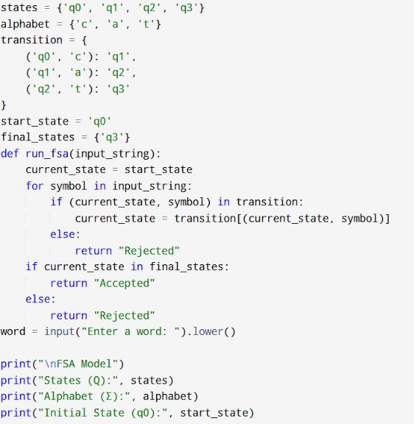
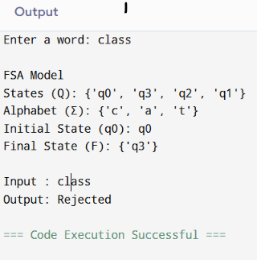
FSA code & output

Slide 6
Applications & Conclusion
Conclusion :
FSA is a key model in NLP.
DFA offers efficient processing.
NFA provides flexible pattern recognition.
Applications :
Lexical Analysis
Tokenization
Spell Checking
Search Engines
Chatbots
Speech Recognition

Slide 7
Thank you..!!

